Slide 1

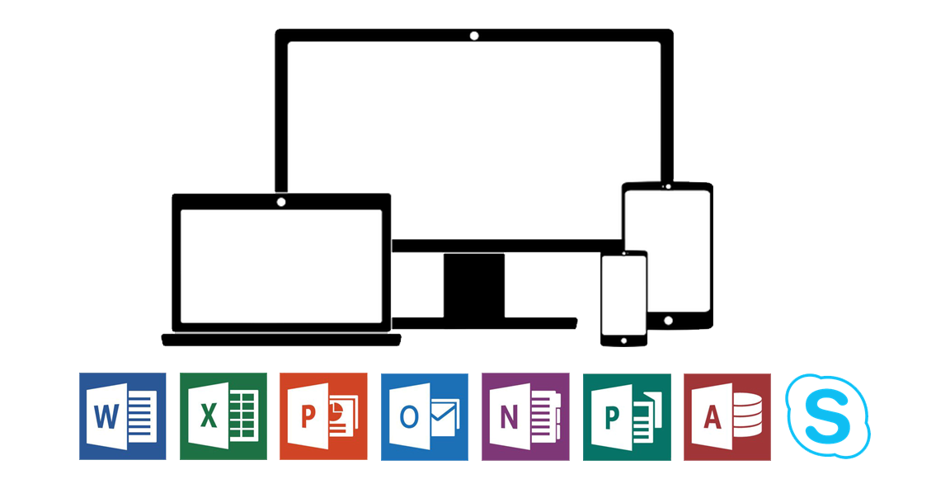
Log in to Office 365 on a smartphone

Slide 2

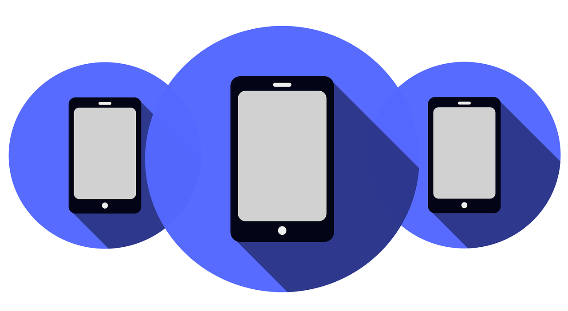
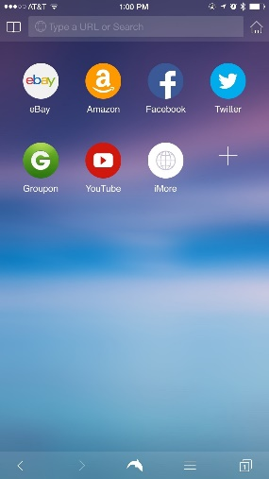




1. Open a browser on your phone
1
Chrome Safari Firefox

Slide 3

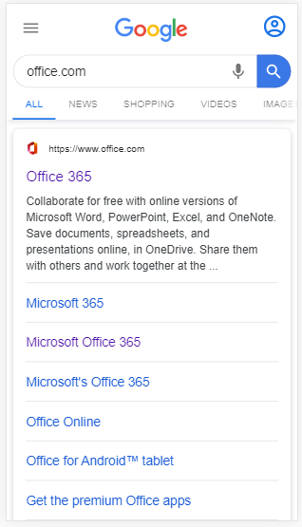
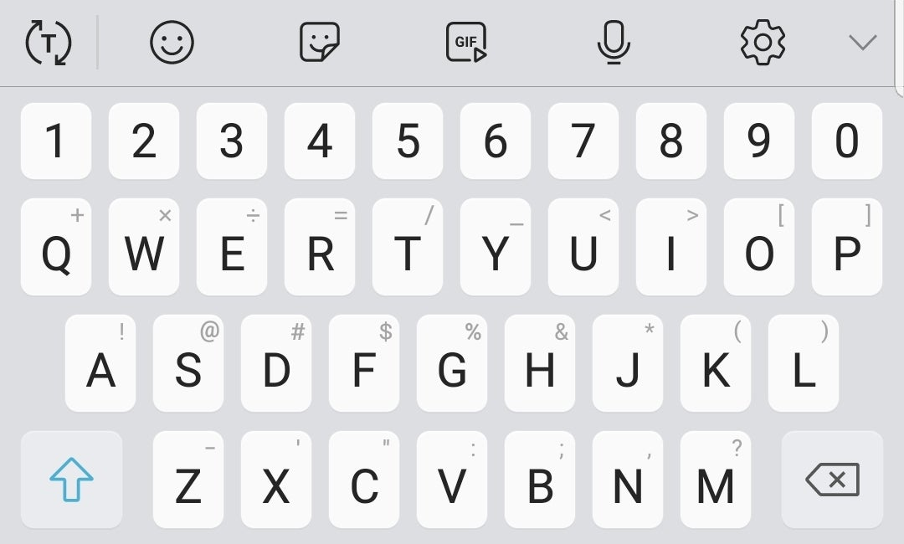
2. Type
Office.com
in the
address bar
2
3. Click
Office 365
3

Slide 4
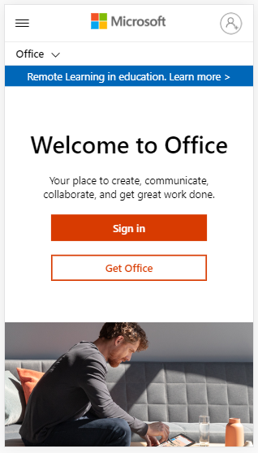
4. Click
Sign in
4

Slide 5
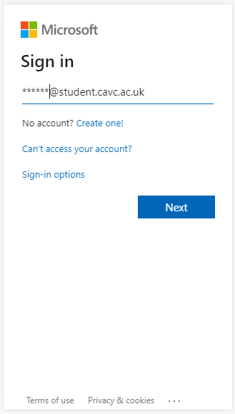
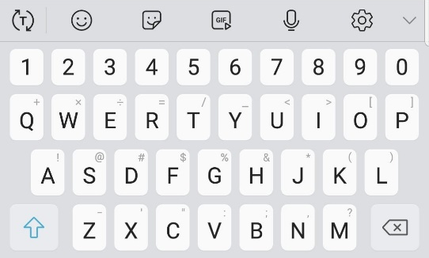
5. Type your
student email address
Example: 234567@student.cavc.ac.uk
5
6
6. Click
Next

Slide 6
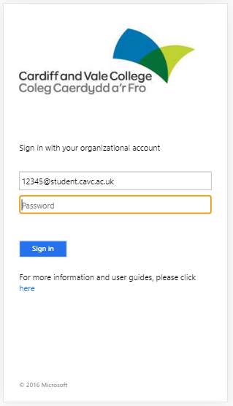
7. Type your
password
7
8. Click
Sign in
8

Slide 7
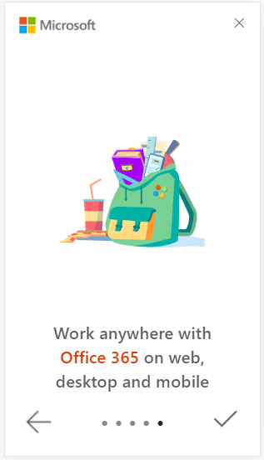
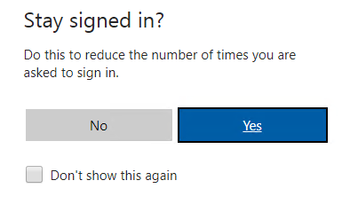
9. To stay
signed in
click Yes
9

Slide 8

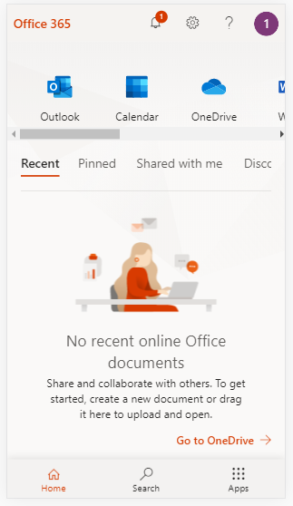
This is the homepage
10. Click Apps
10

Slide 9
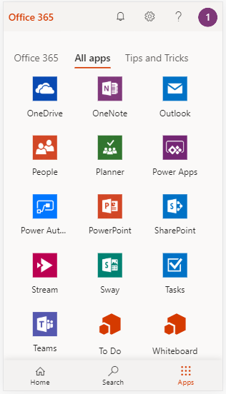


11. Outlook is your student email
11
12. Teams is your class work area
12

